Slide 2
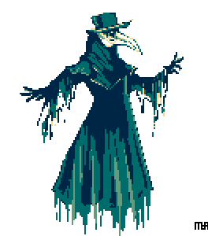
The return of the Black Plague
By Lisa Niedermayr

Slide 3

Table of contents
Causes of the Black Plague
Epidemic in Europe
Effects on modern life
Unit 731 (ななーさんーいち部隊)
21st century and the Black Death

Slide 4
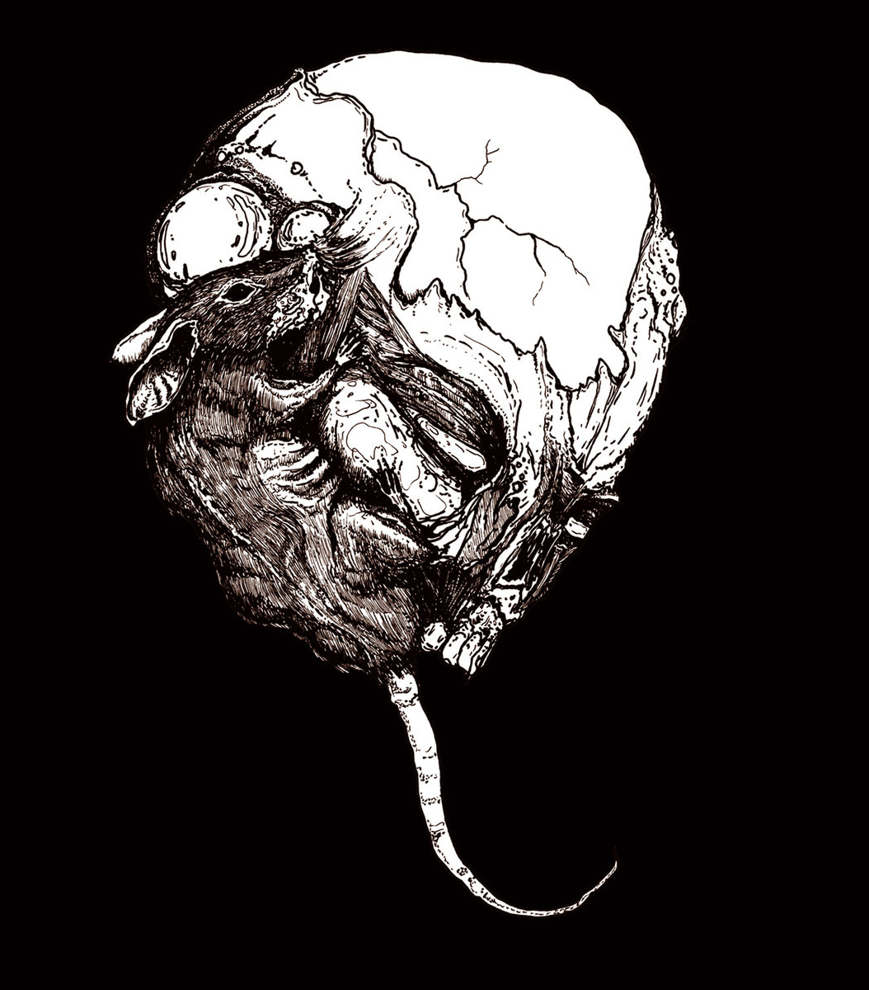
Causes of the Black Plague

Slide 5
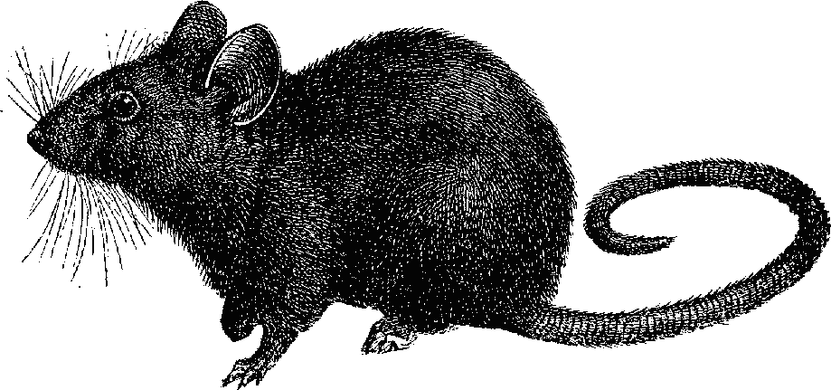
Yersinia Pestis
Causes the main three types:
Bubonic plague
Septicemic plague
Pneumonic plague
Notes:
Plague infected fleas
Usually target rats, but also humans
Bubonic plague 2-6 days after infection
Septicemic plague 2-7 days
Pneumonic plague after one day; 15 hours to start treatment or 100% death rate

Slide 6
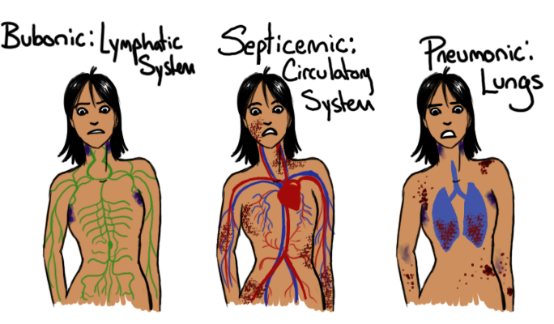
Notes:
Bubonic: Swollen lymph nodes (groin, neck, under armpits)
Septicemic: Rarest type; infection of blood, cause sepsis, bleeding into skin
Pneumonic: cause respiratory failure and shock; death witrhin 36 hours of initial symptoms

Slide 7
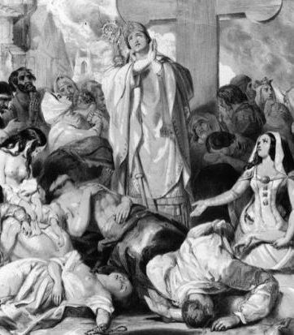
Epidemic in Europe

Slide 8
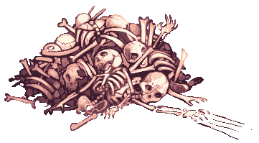
The Black Death
Killed around 30% to 60% of Europe‘s population
Spread due to no hygienic standards

Slide 9
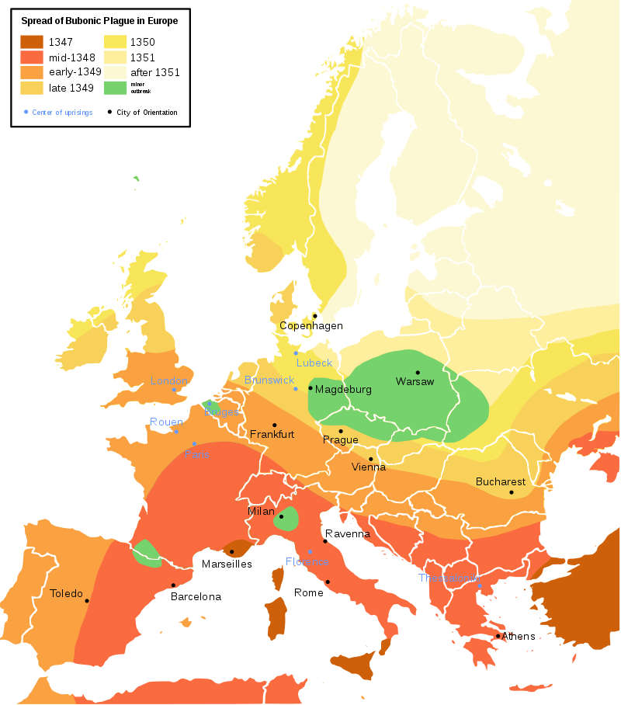
Infection rate
Disease quickly died down until the reintroduction from Central Asia
Poland survived the best
Notes:
Poland was left alone due to strict regulations regarding crossing the border
Jews
Basic hygienic was introduced to the people around them
Less death cases in Jewish communities
Were blamed for that

Slide 10
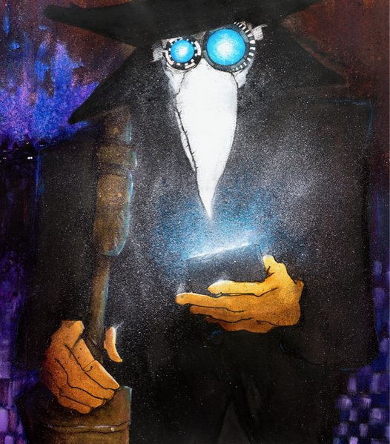
Effects on modern life

Slide 11

Unit 731
Active during WW2
Research team
Responsible for some of the most notorious war crimes
Notes:
Biological and chemical warfare research and development team
Bubonic Plague
Infected fleas in ceramic bombs were dropped on China

Slide 12

New York and the Plague
Traces of the Bubonic plague in the Subway system
No risk for humans
Notes:
Researches found traces of the plague in the subway system
Houses critters (rats, mice, doves?)
As long as not bitten no chance of infection
Do not lick the walls please

Slide 13
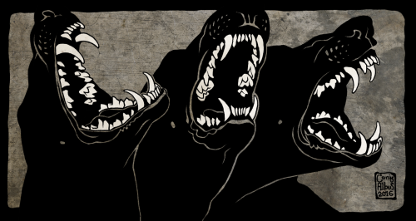
As sick as a dog
Cause was dog from Colorado
Exposed over 100 veterinary staff to the Pneumonic plague
Notes:
December 2017
Dog was sniffing on dead prairie dog
Was put down
No staff members contracted the illness

